Slide 1

Parallel algorithms for matrix multiplication using block decomposition
Saint-Petersburg, 2017

Slide 2
Contents
Problem description
Types of decomposition
Block decomposition
Block-Striped Decomposition
Row-wise Block-Striped Decomposition
Column-wise Block-Striped Decomposition
Checkerboard Data Decomposition
Fox algorithm
Cannon algorithm

Slide 3
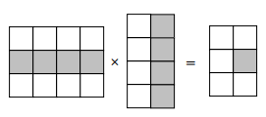
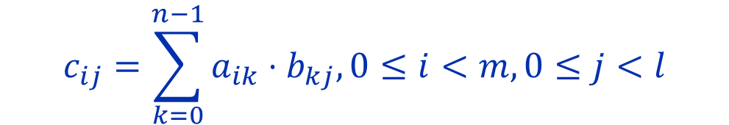
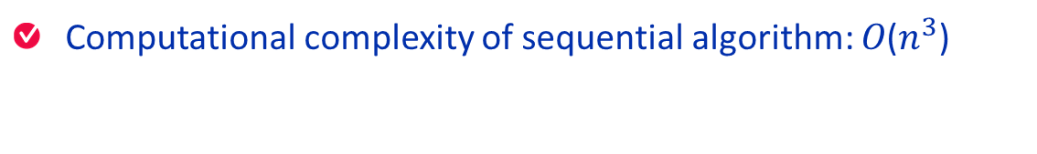

Multiplying the matrix A of size mxn by the matrix B of size nxh leads to obtaining the matrix C of size mxh with each matrix C element defined according to the expression:
$$c_{ij}=\sum_{k=0}^{n−1}{a_{ik}}⋅b_{kj}, 0≤i<m,0≤j<l$$
Computational complexity of sequential algorithm: 𝑂($n^{3}$)

Slide 4
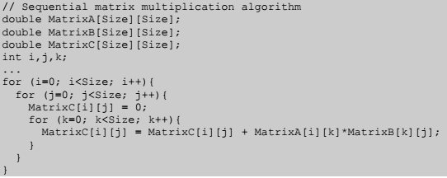

Slide 5
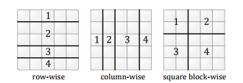

Slide 6
Column-wise Block-Striped Decomposition
# iterations == # subtasks
Each subtask holds a row of matrix A and a column of matrix B
Computing scalar products of rows and columns for each subtask
Transmitting columns of matrix B

Slide 7
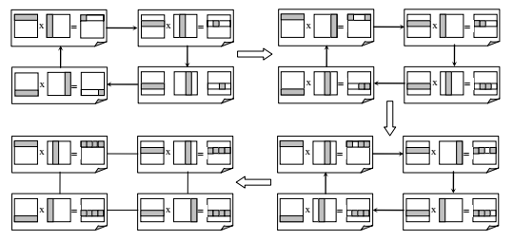
General scheme of data communications

Slide 8
Row-wise Block-Striped Decomposition
# iterations == # subtasks
Data multiplication – rowA x rowB
Each subtask holds a row of matrix A and a row of matrix B
Each subtask contains a row of partial results

Slide 9
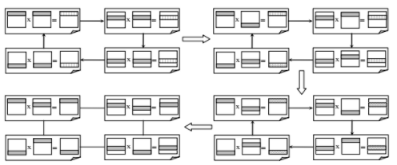
General scheme of data communications

Slide 10
Assumptions
The number of processors available in parallel machine equals to p
Processing nodes are homogeneous, due to this homogeneity it is possible achieve load balancing
Matrices are squared nxn

Slide 11
Fox algorithm
The row i of blocks is broadcasted to the row i of process
The matrix b is partitioned on grid row after row
Each processor has a block of A and a block of B and it can proceed to computation
After computation roll the matrix B up

Slide 12
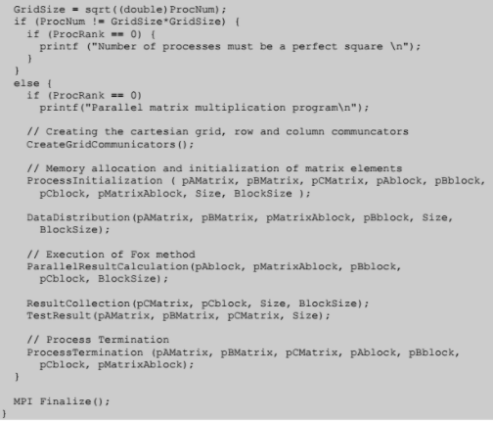

Slide 13
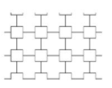
Grid topology
Grid elements
The dimension: 1,2,3 etc.
The sizes of each dimension.
The periodicity if the extreme are adjacent.
Reorder the processors
MPI Methods:
MPI_Cart_create() to create the grid.
MPI_Card_cords() to get the coordinates
MPI_Card_rank() to find the rank.
http://slideplayer.com/slide/8413086/

Slide 14
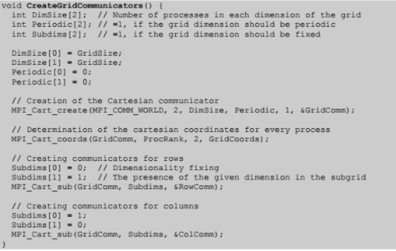
Function creates a communicator 2-dimentional square grid? Determines the coordinates of each process in the grid and creates communication for each row and each column separately

Slide 15
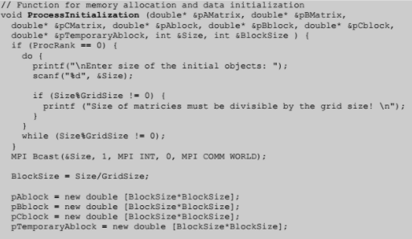
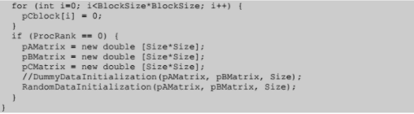

Slide 16
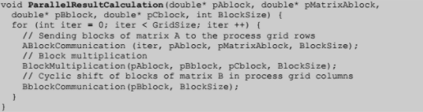
Each iteration consists of
The broadcast of the matrix A block along the processor grid row (ABlockCommuni)
The multiplication of matrix blocks

Slide 17
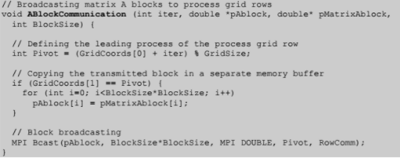

Slide 18
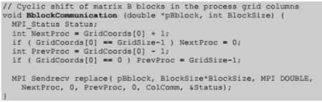

Slide 19
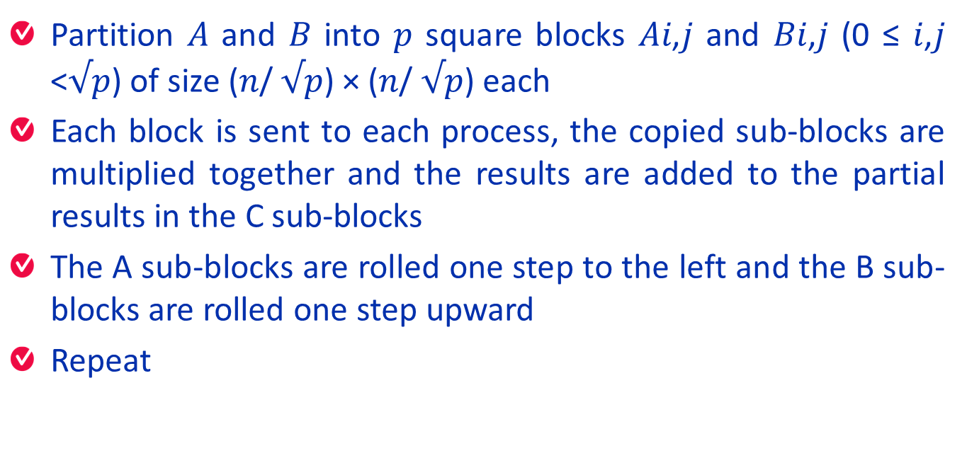
A Simple Paralel Matrix-Matrix Multiplication Cannon Algorithm
Partition 𝐴 and 𝐵 into 𝑝 square blocks 𝐴𝑖,𝑗 and 𝐵𝑖,𝑗 (0 ≤ 𝑖,𝑗 <$√$𝑝) of size (𝑛/ $√$𝑝) × (𝑛/ $√$𝑝) each
Each block is sent to each process, the copied sub-blocks are multiplied together and the results are added to the partial results in the C sub-blocks
The A sub-blocks are rolled one step to the left and the B sub-blocks are rolled one step upward
Repeat

Slide 20
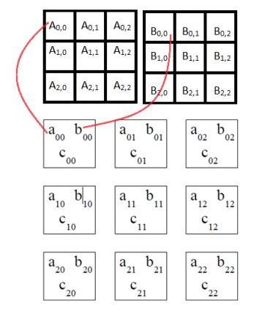

Slide 21
2 | 1 | 5 | 3
6 | 7 | 1 | 6
9 | 2 | 4 | 4
3 | 6 | 7 | 2
6 | 1 | 2 | 3
4 | 5 | 6 | 5
1 | 9 | 8 | -8
4 | 0 | -8 | 5
A
B

Slide 22








$$P_{00}$$
$$P_{01}$$
$$P_{00}$$
$$P_{01}$$
2 | 1 | 5 | 3
6 | 7 | 1 | 6
9 | 2 | 4 | 4
3 | 6 | 7 | 2
6 | 1 | 2 | 3
4 | 5 | 6 | 5
1 | 9 | 8 | -8
4 | 0 | -8 | 5
$$P_{10}$$
$$P_{11}$$
$$P_{10}$$
$$P_{11}$$
A
B

Slide 23
2 | 1 | 5 | 3
6 | 7 | 1 | 6
4 | 4 | 9 | 2
7 | 2 | 5 | 3
6 | 1 | 8 | -8
4 | 5 | -8 | 5
1 | 9 | 2 | 3
4 | 0 | 6 | 5

Slide 24
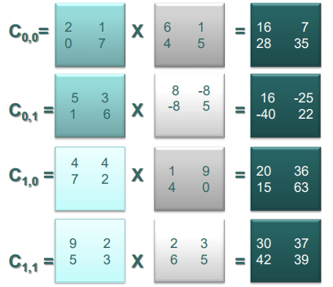

Slide 25
5 | 3 | 2 | 1
1 | 6 | 0 | 7
4 | 4 | 4 | 4
7 | 2 | 7 | 2
1 | 9 | 2 | 3
4 | 0 | 6 | 5
1 | 9 | 8 | -8
4 | 0 | -8 | 5

Slide 26
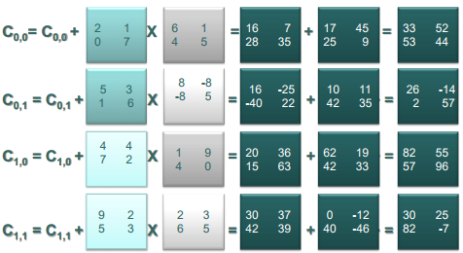

Slide 27
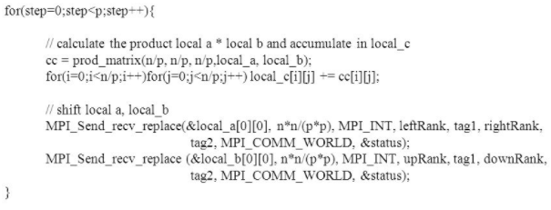
Roll the matrixes

Slide 28
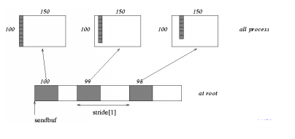
int MPI_Scatterv( void *sendbuf, int *sendcnts, int *displs, MPI_Datatype sendtype, void *recvbuf, int recvcnt, MPI_Datatype recvtype, int root, MPI_Comm comm)
MPI_SCATTERV extends the functionality of MPI_SCATTER by allowing a varying count of data to be sent to each process
sendbuf: address of send buffer
sendcnts: an integer array specifying the number of elements to send to each processor
displs: an integer array. Entry i specifies the displacement (relative to sendbuf from which to take the outgoing data to process i

Slide 29
Block decomposition is maximally good for data access; you have as large a contiguous chunk of data as possible, so you can do matrix operations on nice big sub-matrices
but it's inflexible for parallelism and can cost in terms of load-balancing
Matrix size can be not divisible by the number of processes in a row or column

Slide 30
References
Gupta, Anshul; Kumar, Vipin; , "Scalability of Parallel Algorithms for Matrix Multiplication," Parallel Processing, 1993. ICPP 1993. International Conference on , vol.3, no., pp.115-123, 16-20 Aug. 1993 doi: 10.1109/ICPP.1993.160 URL: http://ieeexplore.ieee.org/stamp/stamp.jsp?tp=&arnumber=4134256&isnumber=4134231
www.open-mpi.org
Michael J. Quinn: Parallel Programming in C with MPI and OpenMP, McGraw Hill Higher Education, 2003.

Slide 31

Thank you!
Saint-Petersburg, 2017

